Slide 1
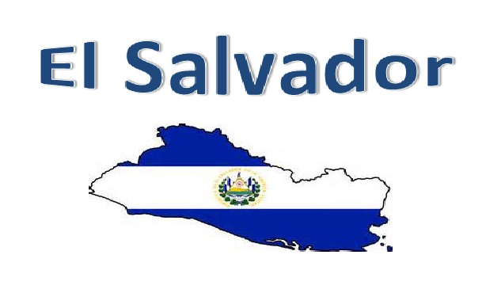
El Salvador
By Alcides Segovia

Slide 2


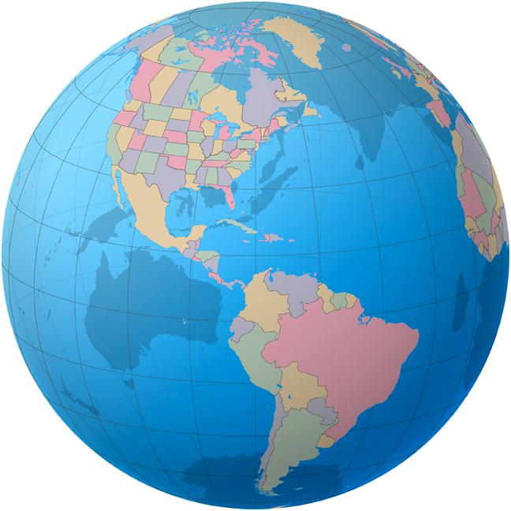




Where is El Salvador?

Slide 3
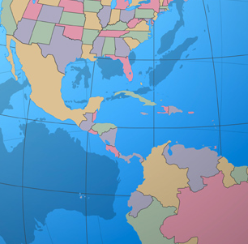
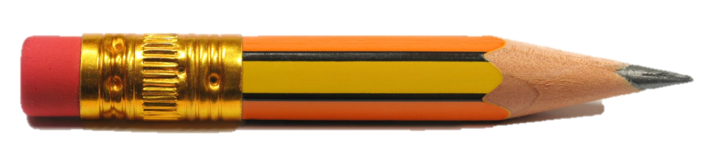

Slide 4
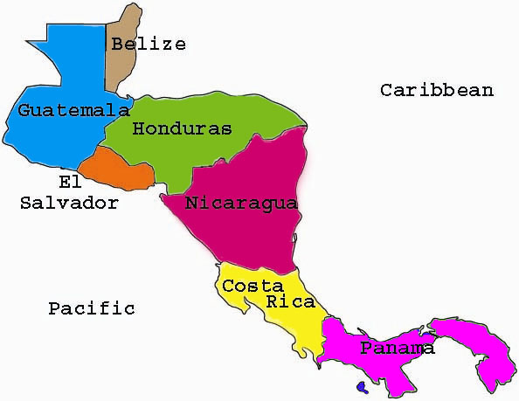

Slide 5
General Information
Official Name: Republic of El Salvador
Capital: San Salvador
Official Language: Spanish
Monetary Unit: U.S. $
Population: 6,109,000 (2013 est.)

Slide 6
History
1821 declared its independence from Spain
1980 - Civil war that lasted 12 years.
“A civil war that ushered . . . Carnage and Devastation. Up to 1,ooo murders per month…”

Slide 7
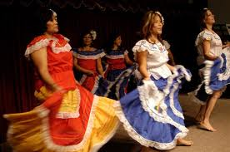
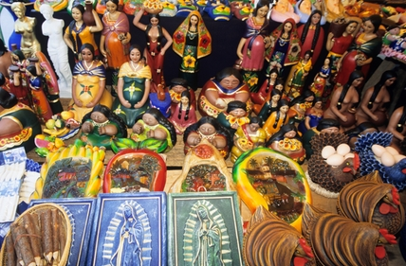
Culture
Mestizo – Mixed Indian and European ancestry.
A mixture of indigenous traditions and Spanish customs.

Slide 8
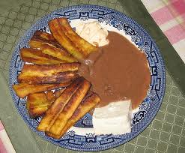
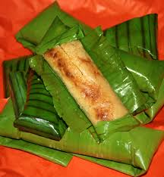
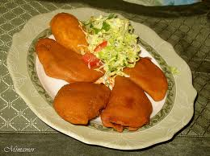
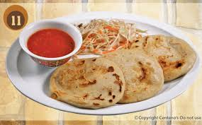
Food

